Slide 1
Layer 2 Security

Slide 2
Layer 2 Security Threats

Slide 3
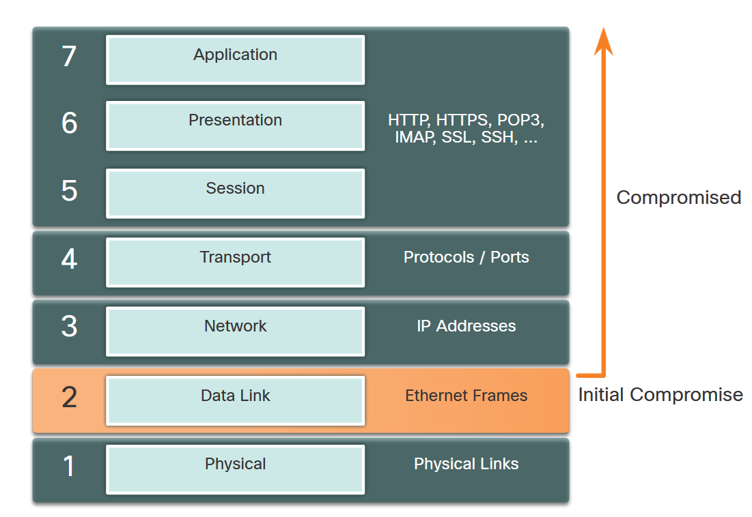
Layer 2 Security Threats
Describe Layer 2 Vulnerabilities
The OSI reference model is divided into seven layers which work independently of each other. Each layer performs a specific function and has core elements that can be exploited.
Network administrators routinely implement security solutions to protect the elements in Layer 3 up through Layer 7 using VPNs, firewalls, and IPS devices. However, as shown in the figure, if Layer 2 is compromised, then all layers above it are also affected.

Slide 4
Layer 2 Security Threats
Switch Attack Categories
Layer 2 is considered to be the weakest link in the network system. Attacks against the Layer 2 LAN infrastructure are highlighted in the table.
Type | Description
MAC Table Attacks | Includes MAC table overflow (also called MAC Address Flooding) Attacks.
VLAN Attacks | Includes VLAN hopping and VLAN double-tagging attacks. It also includes attacks between devices on a common VLAN.
DHCP Attacks | Includes DHCP starvation and DHCP spoofing attacks.
ARP Attacks | Includes ARP spoofing and ARP poisoning attacks.
Address Spoofing Attacks | Includes MAC Address and IP address spoofing attacks.
STP Attacks | Includes Spanning Tree Protocol manipulation attacks.

Slide 5
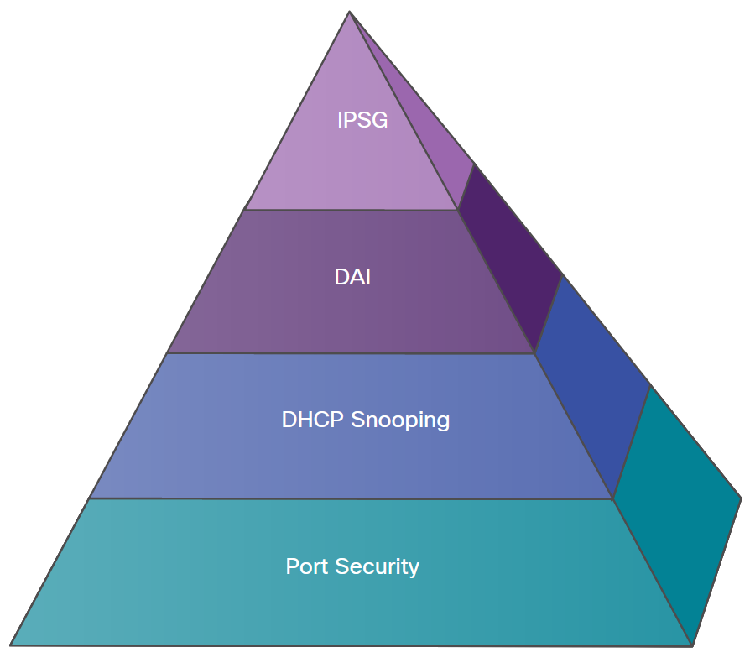
Layer 2 Security Threats
Switch Attack Categories (Cont.)
The figure provides an overview of Cisco solutions that help mitigate Layer 2 attacks.
The following strategies are recommended:
Always use secure variants of these protocols such as SSH, SCP, and SSL.
Use a dedicated management VLAN where nothing but management traffic resides.
Use ACLs to filter unwanted access.
Topic Title | Topic Objective
Port Security | Port security prevents many types of attacks including MAC table overflow attacks and DHCP starvation attacks.
DHCP Snooping | DHCP Snooping prevents DHCP starvation and DHCP spoofing attacks by rogue DHCP servers.
Dynamic ARP Inspection (DAI) | DAI prevents ARP spoofing and ARP poisoning attacks.
IP Source Guard (IPSG) | IP Source Guard prevents MAC and IP address spoofing attacks.

Slide 6
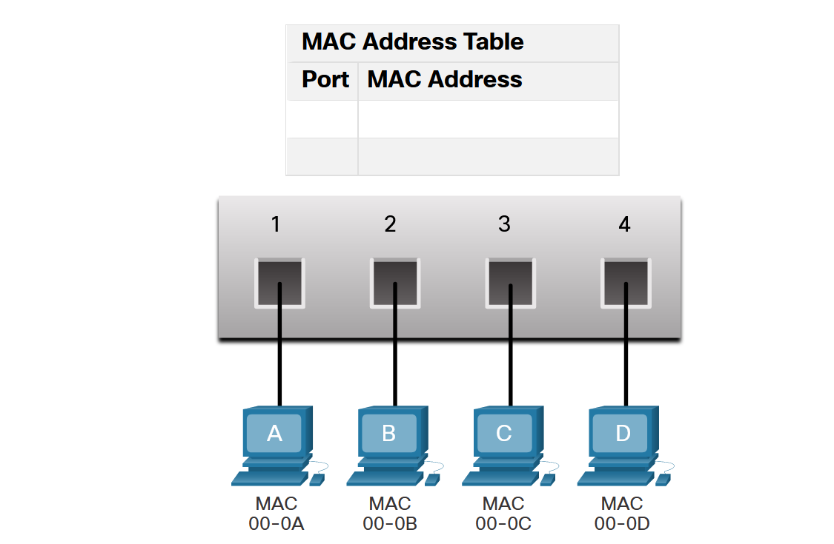
MAC Table Attacks
Switch Fundamentals
A Layer 2 Ethernet switch uses Layer 2 MAC addresses to make forwarding decisions. It is completely unaware of the data (protocol) being carried in the data portion of the frame, such as an IPv4 packet, an ARP message, or an IPv6 ND packet. The switch makes its forwarding decisions based solely on the Layer 2 Ethernet MAC addresses.
The table shows the MAC Address Table which has not yet learned the MAC addresses for the four attached PCs.

Slide 7
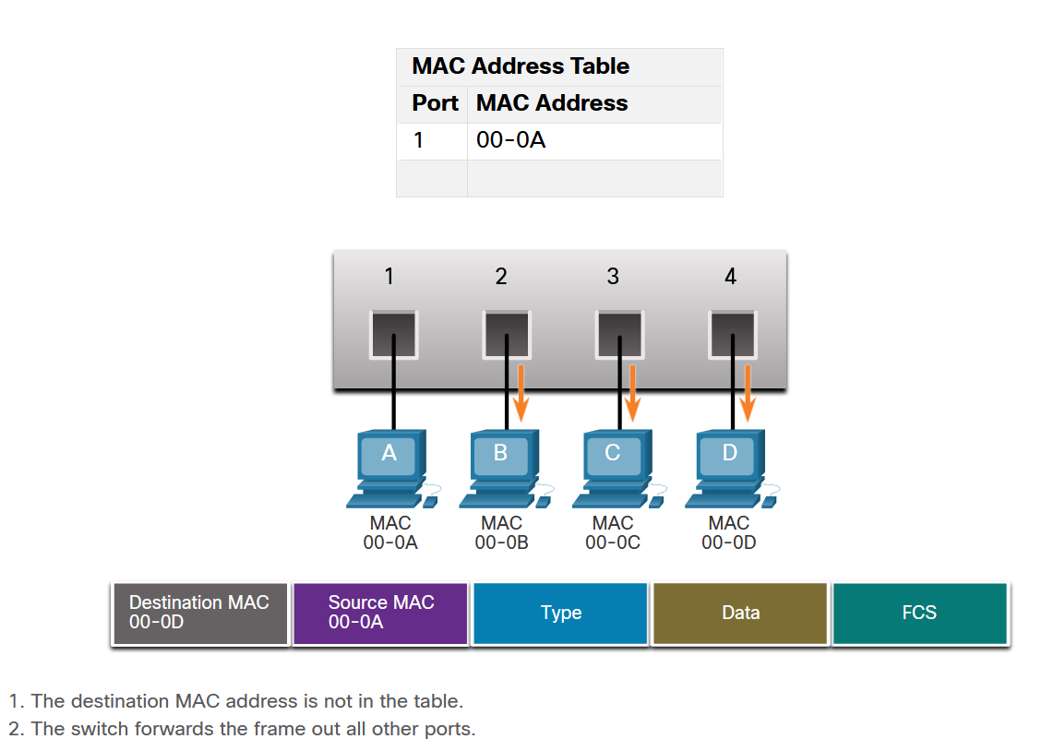
MAC Table Attacks
Switch Learning and Forwarding
The switch dynamically builds the MAC address table by examining the source MAC address of the frames that are received on a port. The switch forwards frames by searching for a match between the destination MAC address in the frame and an entry in the MAC address table.
Every frame that enters a switch is checked for new information to learn. The switch does this by examining the source MAC address of the frame and the port number where the frame entered the switch.
If the source MAC address does not exist, it is added to the table along with the incoming port number. If the source MAC address does exist, the switch updates the refresh timer for that entry in the table. By default, most Ethernet switches keep an entry in the table for 5 minutes.

Slide 8
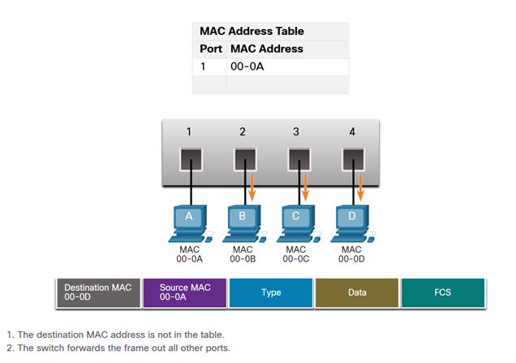
MAC Table Attacks
Switch Learning and Forwarding (Cont.)
If the destination MAC address is a unicast address, the switch will look for a match between the destination MAC address of the frame and an entry in its MAC address table. If the destination MAC address is in the table, it will forward the frame out the specified port. If the destination MAC address is not in the table, the switch will forward the frame out all ports except the incoming port. This is called an unknown unicast.
As shown in the figure, the switch does not have the destination MAC address in its table for PC-D, so it sends the frame out all ports except port 1.

Slide 9
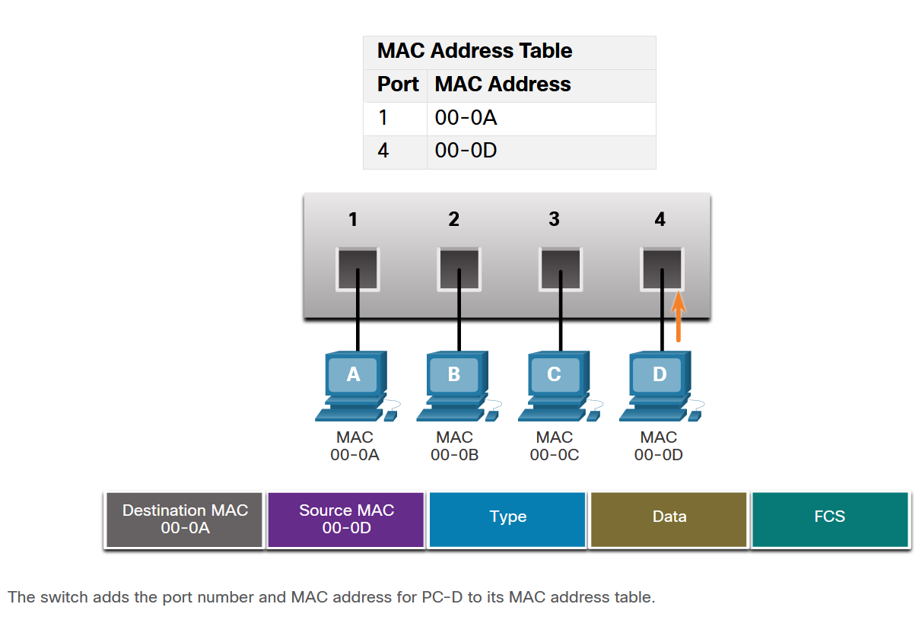
MAC Table Attacks
Filtering Frames
As a switch receives frames from different devices, it populates its MAC address table by examining the source MAC address of every frame. When the MAC address table of the switch contains the destination MAC address, it filters the frame and forwards out a single port.
In the figure, PC-D is replying back to PC-A. The switch sees the MAC address of PC-D in the incoming frame on port 4. The switch then puts the MAC address of PC-D into the MAC Address Table associated with port 4.

Slide 10
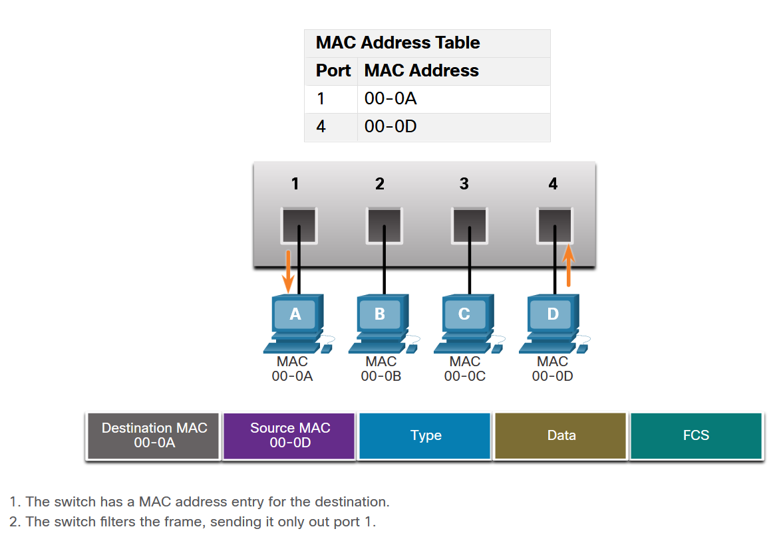
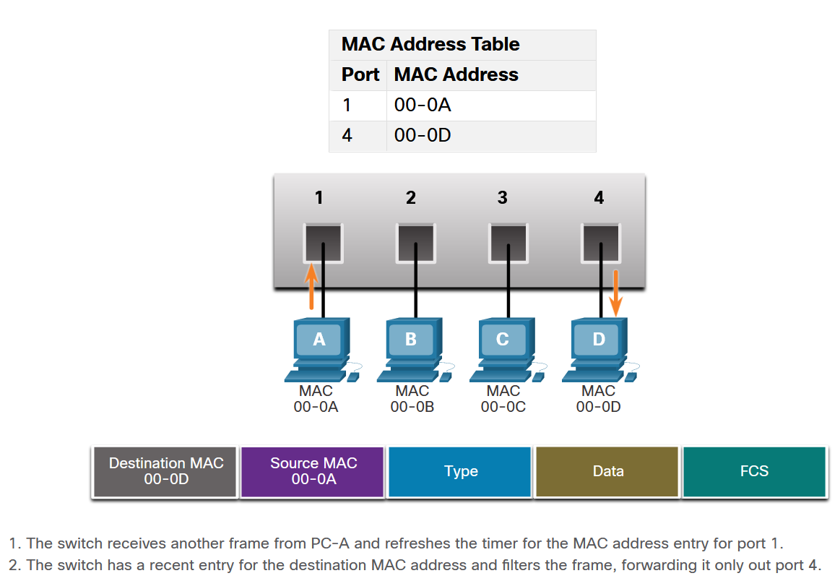
MAC Table Attacks
Filtering Frames (Cont.)
PC-A sends another frame to PC-D as shown in the figure. The MAC address table already contains the MAC address for PC-A; therefore, the five-minute refresh timer for that entry is reset. Next, because the switch table contains the destination MAC address for PC-D, it sends the frame only out port 4.
Next, because the switch has destination MAC address for PC-A in the MAC Address Table, it will send the frame only out port 1, as shown in the figure.

Slide 11
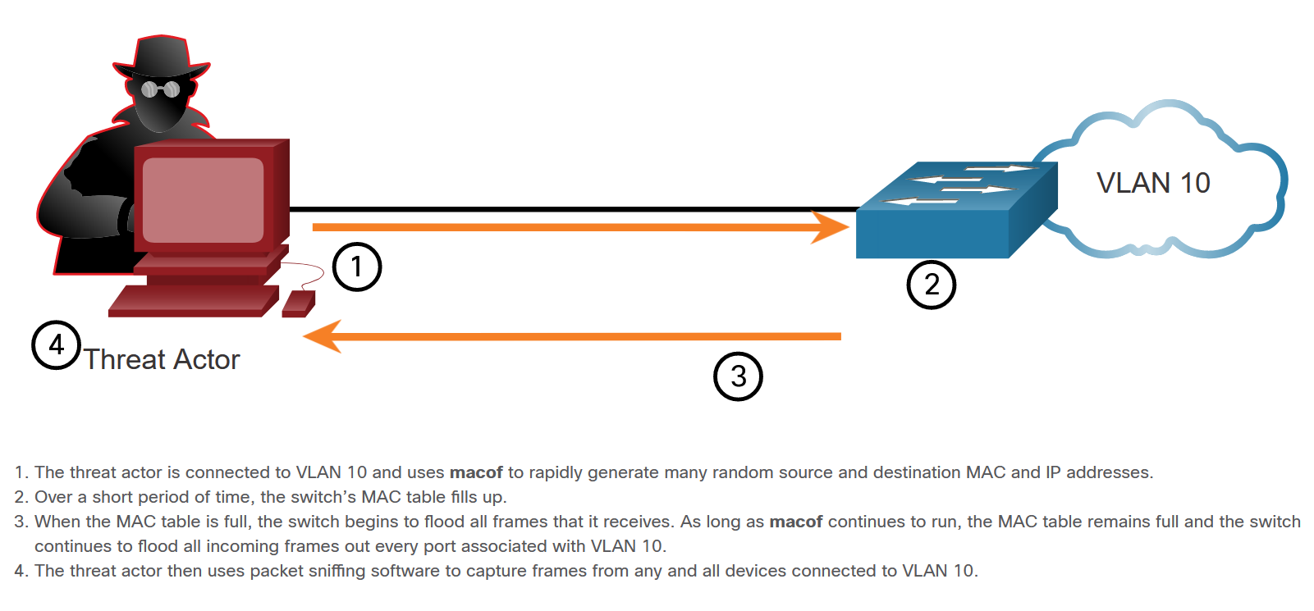
MAC Table Attacks
MAC Address Table Flooding
All MAC tables have a fixed size and consequently, a switch can run out of resources in which to store MAC addresses. MAC address flooding attacks take advantage of this limitation by bombarding the switch with fake source MAC addresses until the switch MAC address table is full.

Slide 12
MAC Table Attacks
MAC Address Table Attack Mitigation
What makes tools such as macof so dangerous is that an attacker can create a MAC table overflow attack very quickly. These attack tools are dangerous because they not only affect the local switch, but because they can also affect other connected Layer 2 switches.
To mitigate MAC address table overflow attacks, network administrators must implement port security. Port security will only allow a specified number of source MAC addresses to be learned on the port.

Slide 13
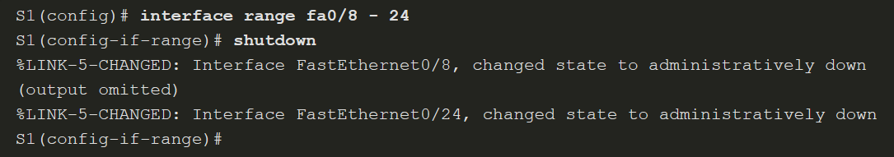
Mitigate MAC Table Attacks
Secure Unused Ports
All switch ports (interfaces) should be secured before the switch is deployed for production use. How a port is secured depends on its function.
A simple method that many administrators use to help secure the network from unauthorized access is to disable all unused ports on a switch.

Slide 14
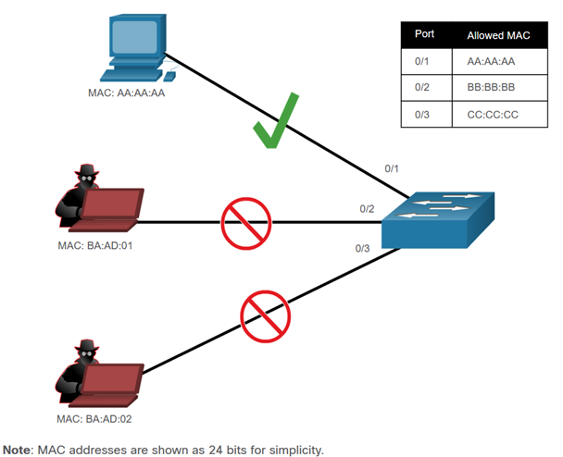
Mitigate MAC Table Attacks
Mitigate MAC Address Table Attacks
Port security limits the number of valid MAC addresses allowed on a port. It allows an administrator to manually configure MAC addresses for a port or to permit the switch to dynamically learn a limited number of MAC addresses. When a port that is configured with port security receives a frame, the source MAC address of the frame is compared to the list of secure source MAC addresses that were manually configured or dynamically learned on the port.
By limiting the number of permitted MAC addresses on a port to one, port security can be used to control unauthorized access to the network, as shown in the figure.

Slide 15
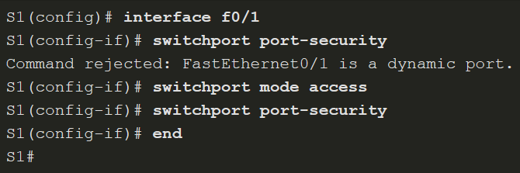
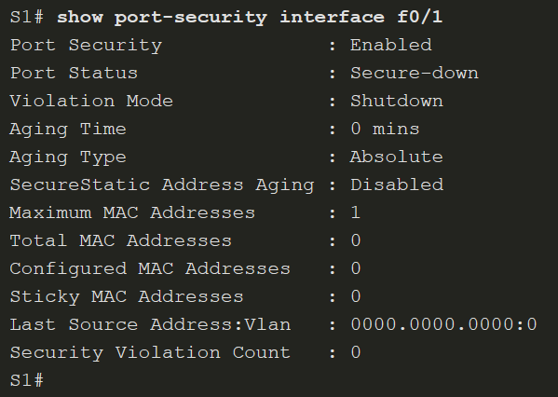
Mitigate MAC Table Attacks
Enable Port Security
The switchport port-security interface configuration command for port security can only be configured on manually configured access ports or manually configured trunk ports. By default, Layer 2 switch ports are set to dynamic auto (trunking on).
Use the show port-security interface command to display the current port security settings for FastEthernet 0/1, as shown in the example. Notice that port security is enabled, and the port status is Secure-down, which means there are no devices attached and no violation has occurred. Also, the violation mode is Shutdown, and the maximum number of MAC addresses allowed is 1.

Slide 16
Mitigate MAC Table Attacks
Limit and Learn MAC Addresses
To set the maximum number of MAC addresses allowed on a port, use the switchport port-security maximum value command.
The switch can be configured to learn about MAC addresses on a secure port in one of three ways:
Manually Configured - The administrator manually configures a static MAC address(es) by using the switchport port-security mac-address mac-address command for each secure MAC address on the port.
Dynamically Learned - When the switchport port-security command is entered, the current source MAC for the device connected to the port is automatically secured but is not added to the startup configuration. If the switch is rebooted, the port will have to re-learn the device’s MAC address.
Dynamically Learned – Sticky - The administrator can enable the switch to dynamically learn the MAC address and “stick” them to the running configuration by using the switchport port-security mac-address sticky command.

Slide 17
Mitigate MAC Table Attacks
Port Security Violation Modes
If the MAC address of a device that is attached to the port differs from the list of secure addresses, then a port violation occurs. By default, the port enters the error-disabled state. To set the port security violation mode, use the switchport port-security violation { protect | restrict | shutdown} command.
The following table shows security violation mode descriptions.
Mode | Description
shutdown (default) | The port transitions to the error-disabled state immediately, turns off the port LED, and sends a syslog message. It increments the violation counter. When a secure port is in the error-disabled state, an administrator must re-enable it by entering the shutdown and no shutdown commands.
restrict | The port drops packets with unknown source addresses until you remove a sufficient number of secure MAC addresses to drop below the maximum value or increase the maximum value. This mode causes the Security Violation counter to increment and generates a syslog message.
protect | This is the least secure of the security violation modes. The port drops packets with unknown MAC source addresses until you remove a sufficient number of secure MAC addresses to drop below the maximum value or increase the maximum value. No syslog message is sent.

Slide 18
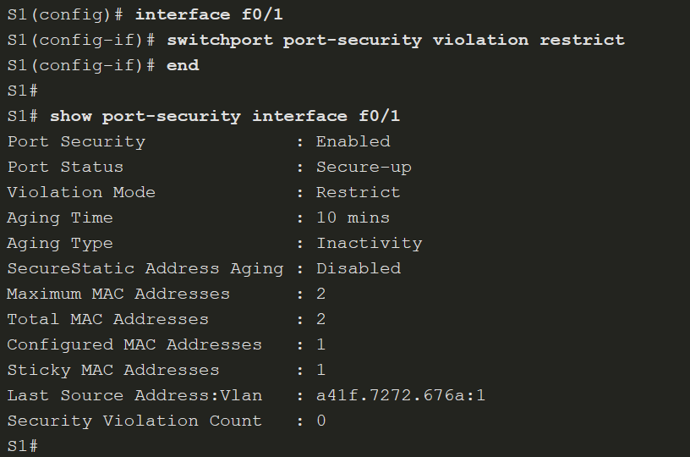
Mitigate MAC Table Attacks
Port Security Violation Modes (Cont.)
The following table shows a security violation mode comparison.
Violation Mode | Discards Offending Traffic | Sends Syslog Message | Increase Violation Counter | Shuts Down Port
Protect | Yes | No | No | No
Restrict | Yes | Yes | Yes | No
Shutdown | Yes | Yes | Yes | Yes
The figure on the right, shows an administrator changing the security violation to “restrict”. The output of the show port-security interface command confirms that the change has been made.

Slide 19
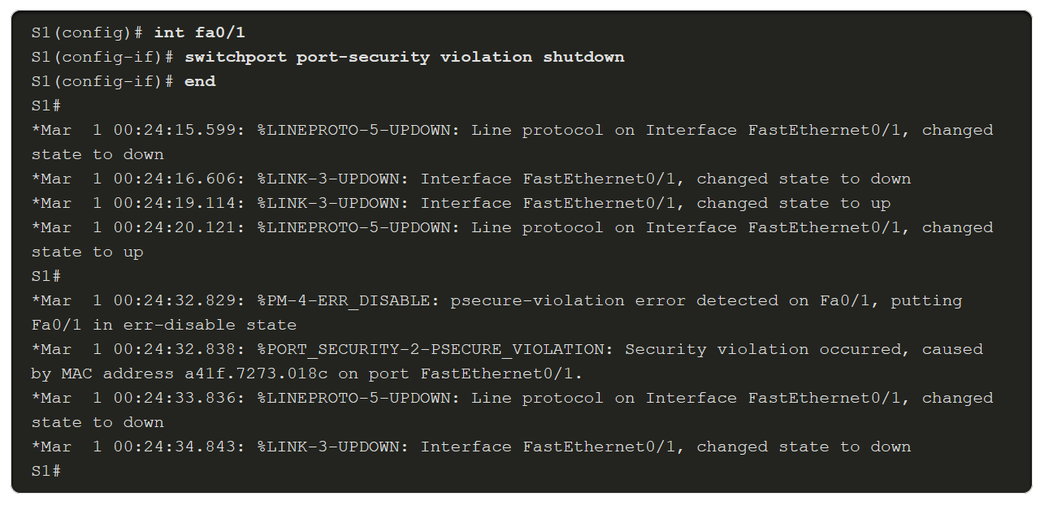
Mitigate MAC Table Attacks
Ports in error-disabled State
What happens when the port security violation is shutdown and a port violation occurs? The port is physically shut down and placed in the error-disabled state, and no traffic is sent or received on that port.
In the example, the port security violation is changed back to the default shutdown setting. Then the host with MAC address a41f.7272.676a is disconnected and a new host is plugged into Fa0/1. Notice that a series of port security related messages are generated on the console.

Slide 20
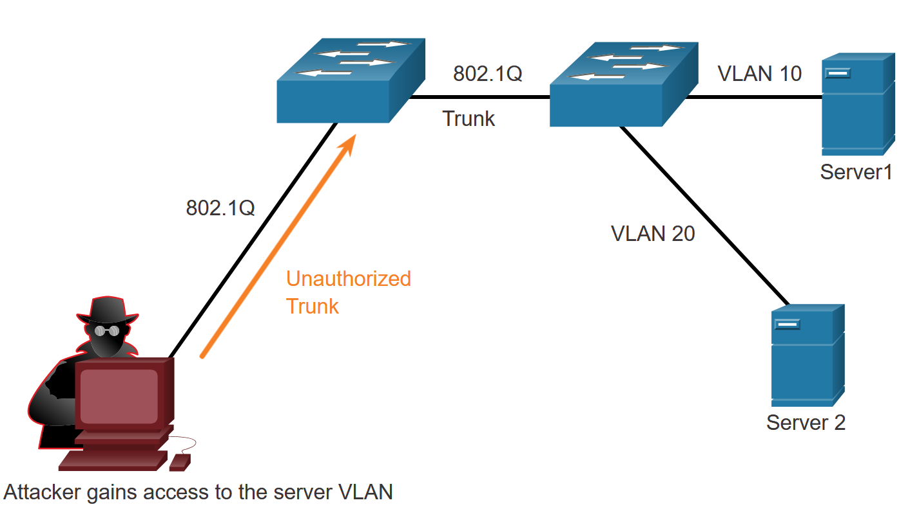
Mitigate VLAN Attacks
VLAN Hopping Attacks
Two types of VLAN attacks are VLAN hopping attacks and VLAN double-tagging attacks.
In a basic VLAN hopping attack, the threat actor configures a host to act like a switch to take advantage of the automatic trunking port feature enabled by default on most switch ports.
The threat actor configures the host to spoof 802.1Q signaling and Cisco-proprietary Dynamic Trunking Protocol (DTP) signaling to trunk with the connecting switch. If successful,
the switch establishes a trunk link with the host, as shown in the figure. Now the threat actor can access all the VLANs on the switch. The threat actor can send and receive traffic on any VLAN, effectively hopping between VLANs.

Slide 21
Mitigate VLAN Attacks
VLAN Double-Tagging Attack
A threat actor in specific situations could embed a hidden 802.1Q tag inside the frame that already has an 802.1Q tag. This tag allows the frame to go to a VLAN that the original 802.1Q tag did not specify. The following explains the steps taken by the threat actor.
The threat actor sends a double-tagged 802.1Q frame to the switch. The outer header has the VLAN tag of the threat actor, which is the same as the native VLAN of the trunk port. For the purposes of this example, assume that this is VLAN 10. The inner tag is the victim VLAN.
The frame arrives on the first switch, which looks at the first 4-byte 802.1Q tag. The switch sees that the frame is destined for VLAN 10, which is the native VLAN. The switch forwards the packet out all VLAN 10 ports after stripping the VLAN 10 tag. The frame is not retagged because it is part of the native VLAN. At this point, the VLAN 20 tag is still intact and has not been inspected by the first switch.
The frame arrives at the second switch which has no knowledge that it was supposed to be for VLAN 10. Native VLAN traffic is not tagged by the sending switch as specified in the 802.1Q specification. The second switch looks only at the inner 802.1Q tag that the threat actor inserted and sees that the frame is destined for VLAN 20, the target VLAN. The second switch sends the frame on to the target or floods it, depending on whether there is an existing MAC address table entry for the target.

Slide 22
Mitigate VLAN Attacks
Mitigating VLAN Hopping Attacks
Use the following steps to mitigate VLAN hopping attacks:
Step 1: Disable DTP (auto trunking) negotiations on non-trunking ports by using the switchport mode access interface configuration command.
Step 2: Disable unused ports and put them in an unused VLAN. In the example it is VLAN 1000.
Step 3: Manually enable the trunk link on a trunking port by using the switchport mode trunk command.
Step 4: Disable DTP (auto trunking) negotiations on trunking ports by using the switchport nonegotiate command.
Step 5: Set the native VLAN to a VLAN other than VLAN 1 by using the switchport trunk native vlan vlan_number command.

Slide 23
Mitigate DHCP Attacks
DHCP Attacks
Two types of DHCP attacks are DHCP starvation and DHCP spoofing. Both attacks are mitigated by implementing DHCP snooping.
DHCP Starvation Attack - The goal of the DHCP starvation attack is DoS for connecting clients. DHCP starvation attacks require an attack tool such as Gobbler.
DHCP Spoofing Attack - A DHCP spoofing attack occurs when a rogue DHCP server is connected to the network and provides false IP configuration parameters to legitimate clients. A rogue server can provide a variety of misleading information including wrong default gateway, wrong DNS server, and wrong IP address.

Slide 24
Mitigate DHCP Attacks
DHCP Attacks Mitigation
It is easy to mitigate DHCP starvation attacks by using port security. However, mitigating DHCP spoofing attacks requires more protection.
DHCP spoofing attacks can be mitigated using DHCP snooping on trusted ports. DHCP snooping also helps mitigate against DHCP starvation attacks by rate limiting the number of DHCP discovery messages that an untrusted port can receive. DHCP snooping builds and maintains a DHCP snooping binding database that the switch can use to filter DHCP messages from untrusted sources.
When DHCP snooping is enabled on an interface or VLAN, and a switch receives a packet on an untrusted port, the switch compares the source packet information with the information held in the DHCP snooping binding table. The switch will deny packets containing specific information.

Slide 25
Mitigate ARP Attacks
ARP Attacks
In a typical attack, a threat actor can send unsolicited ARP Replies to other hosts on the subnet with the MAC Address of the threat actor and the IPv4 address of the default gateway.
There are many tools available on the internet to create ARP man-in-the-middle attacks including dsniff, Cain & Abel, ettercap, Yersinia, and others. IPv6 uses ICMPv6 Neighbor Discovery Protocol for Layer 2 address resolution. IPv6 includes strategies to mitigate Neighbor Advertisement spoofing, similar to the way IPv6 prevents a spoofed ARP Reply.
ARP spoofing and ARP poisoning are mitigated by implementing Dynamic ARP Inspection (DAI).

Slide 26
Mitigate ARP Attacks
Dynamic ARP Inspection
In a typical ARP attack, a threat actor can send unsolicited ARP requests to other hosts on the subnet with the MAC Address of the threat actor and the IP address of the default gateway.
Dynamic ARP inspection (DAI) requires DHCP snooping and helps prevent ARP attacks by:
Not relaying invalid or gratuitous ARP Requests out to other ports in the same VLAN.
Intercepting all ARP Requests and Replies on untrusted ports.
Verifying each intercepted packet for a valid IP-to-MAC binding.
Dropping and logging ARP Requests coming from invalid sources to prevent ARP poisoning.
Error-disabling the interface if the configured DAI number of ARP packets is exceeded.

